Slide 1

HandyMan
By Team 3:
Arinze Nnaji – Java/JS Developer.
Manzino Ukah –JAVASCRIPT / PHP developer
Ekpeyong Okpo – JAVA developer
Emmanuel Kuye – QUALITY ANALYST ENGINEEER
Funsho Olaniyi – JAVASCRIPT developer
Nwaoduh Ezinna – TECH BUSINESS DEVELOPer
PROJECT: UBER FOR HANDY APP

Slide 2

Big Un-Met Market Problem:
User Survey Problem Report:
Handy Man Survey Problem Report:
Difficulty with contacting handy men on short notice.
Overpricing from handy men in a location.
Lots of untrained & unverified Handy Men.
Need for Increased clients.
Newly trained handy men not attracting clients in a short interval.
Under pricing from clients in a location.

Slide 3
Objective of the HandyMan App
Connecting quality handy men to jobs nearest to them.
Improving the quality of work from handy men through User based ratings.
According to Guardian Business News : “Hunting for a competent and honest handy man is like searching for a needle in the proverbial haystack”.
Providing the best pricing for both handymen and the users.
Cross Platform Solution for Android & IOS users.

Slide 4

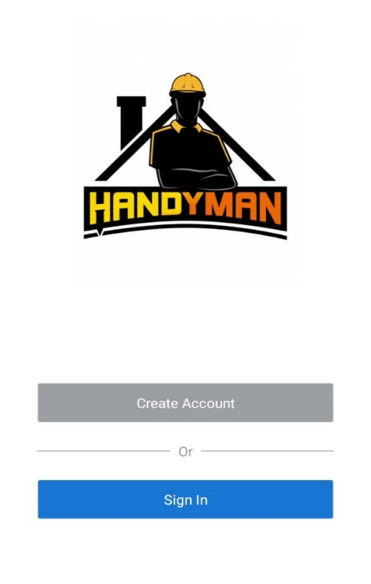
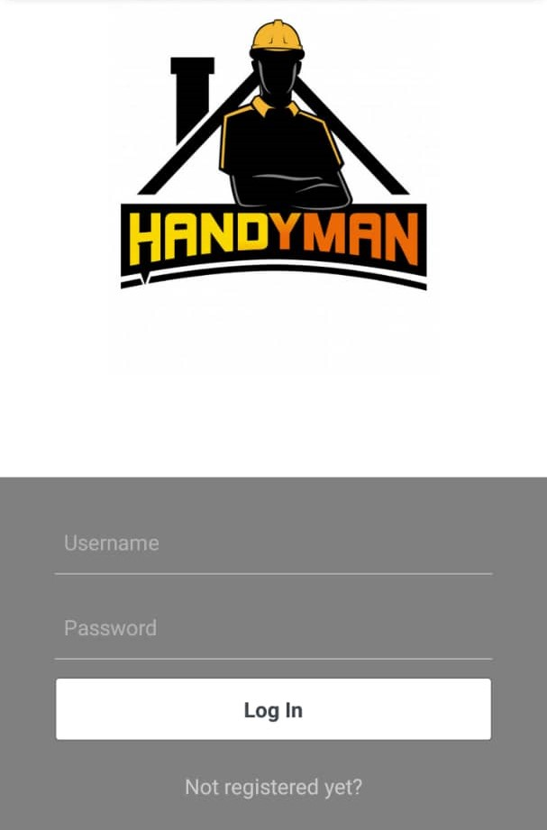
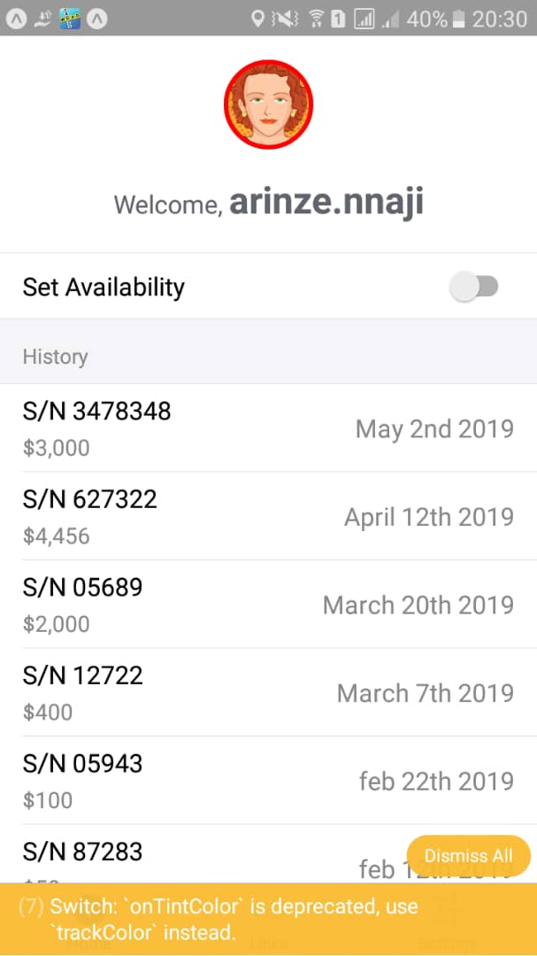
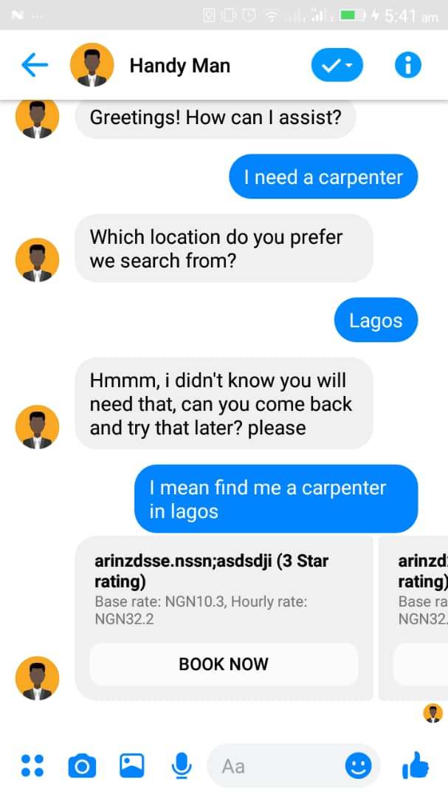
HandyMan User Interfaces

Slide 5
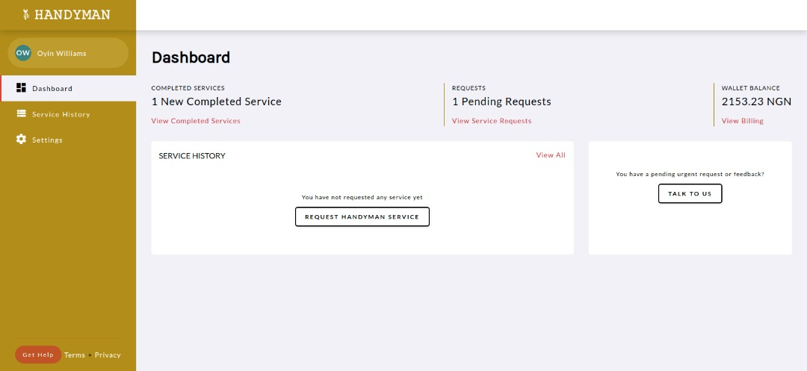
HandyMan User Wallet

Slide 6
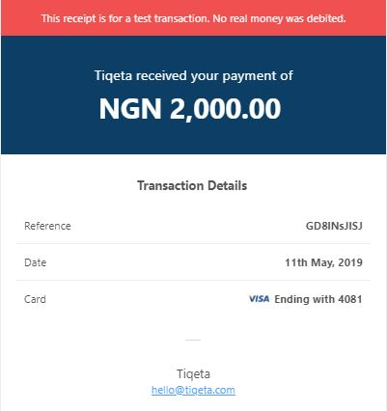
HandyMan Payment Receipt

Slide 7
Unique Selling Points For HandyMan App
Ease of Usage.
Real Time Notification of User Request
Conventional Chat BoT Experience (NLP).
Location Based Connection between Customer & Handy Man.

Slide 8
USER JOURNEY
Handy Man App
User App
Admin
Chat BoT Using NLP on Facebook Messenger:
User chats with Handy Man Bot on FB messenger requesting a handy man.
Chat BoT Queries DB picking intent from text in the chat.
Chat BoT Filters and Suggests Handy Man Based on User Intent (Location & Category).
The BoT redirects user to make payment in user wallet.
User Books A Handy Man.
Periodic notification when money in wallet is depleted based on hours of work.
Accepts End Job when work is completed and Handy Man is Paid
Registration:
Name.
Occupation.
Post Registration:
Sets availability to ON.
Handy man Accepts Job & will not get further notification from HandyMan BoT .
Performs Job and Ends Job.
Will be recommended when available.
History
Shows transaction history for registered handy men.
Total Accrued Revenue and Total Accrued Commission.

Slide 9
HandyMan MINIMUM VALUE PRODUCT (MVP)
Registration.
User engagement with Chat BoT using NLP(Natural Language Processing) integration.
Database Query Based on Category and Location.
Handy Man Profile Displaying Star Rating and “Book Now” Button.
Payment Processing Using Paystack.
End Job.

Slide 10
Market Segment / HandyMan Business Model/Competitor
Revenue Model
Expense Model
Market Segment
As a high volume business, we would adopt the fixed commission revenue model.
Implementation of a user wallet system to protect our partners.
5% commission from every successfully completed job.
Review of Revenue Model Bi-Annually.
Online Marketing (Users):
Facebook Marketing.
Google AdWords.
SM influencers.
Weekly Acquisition of Handy Men:
Awareness Creation.
Legal Engagements.
Review of Expense Model Bi-Annually.
HandyMan is a multi-market segment product.
The product is aimed at the middle to high income class with basic tech knowledge.
Local Competitor:
ArtisanOga.com
Jambolo.com

Slide 11
HandyMan Potential Growth Partners
Financial Partners:
Fintech Companies (Paga, Quickteller etc.)
Media Partners:
Tech Blogs ( TechCabal, TechCrunch)
Job Recruitment Partners.
Jobber Man.
Myjobmag etc.
Vocational Skill Association:
APPN (Association of professional plumbers of Nigeria).
Online Marketing Channels:
S.E.O (Search Engine Optimization)
S.E.M (Search Engine Marketing e.g. AdWords.).
Email Marketing.
Facebook Marketing

Slide 12
Nigeria’s HandyMan Market Projection/Product RoadMap
Nigeria has a population of Over 190 Million People.
According to SMEDAN (Small and Medium Enterprises Development Agency of Nigeria) Annual Report of 2013 :
Nigeria has over 36 Million Artisans.
20.4 Million are readily available (Graduates from Technical Schools).
16.4 Million are not readily available(Informally Trained )
Conservatively speaking with just 10% of the market share HandyMan will partner with 3.6 Million Artisans/ Handy Men in a market of over 190 Million People.
Sprint 2 (Further Improvement):
User Reviews/Complaint.
Price Range Booking. etc

Slide 13


